Slide 1


DATA SCIENCE INTERNSHIP
SQL PROJECT – TASK 1 : HR DATA ANALYSIS

Slide 2

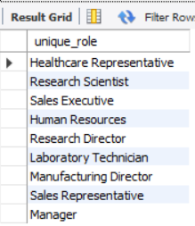

1) Retrieve the total number of employees in the dataset.
2) List all unique job roles in the dataset.

Slide 3

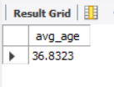
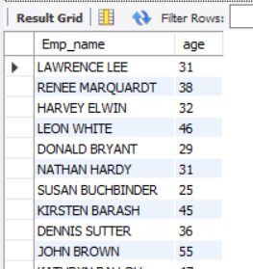
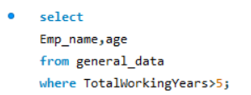
3) Find the average age of employees.
4) Retrieve the names and ages of employees who have worked at the company for more than 5 years.

Slide 4
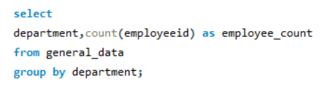
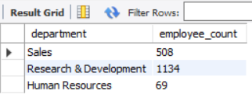
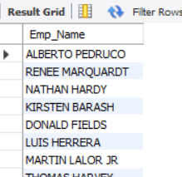
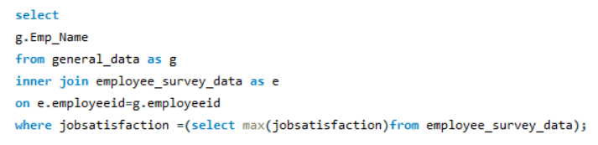
5) Get a count of employees grouped by their department.
6) List employees who have 'High' Job Satisfaction.

Slide 5
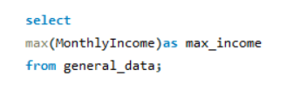

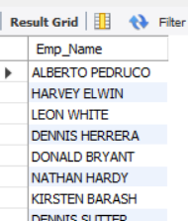
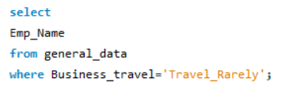
7) Find the highest Monthly Income in the dataset.
8) List employees who have 'Travel_Rarely' as their BusinessTravel type.

Slide 6
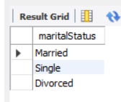

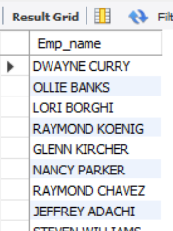
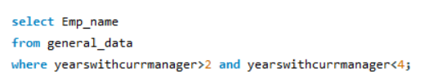
9) Retrieve the distinct MaritalStatus categories in the dataset.
10) Get a list of employees with more than 2 years of work experience but less than 4 years in their current role.

Slide 7
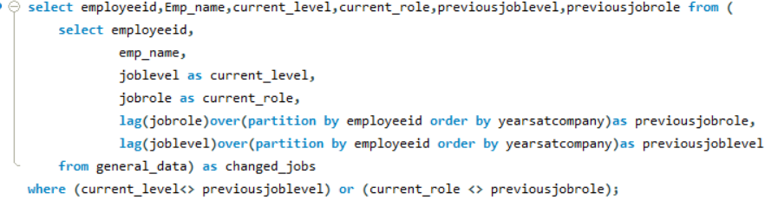

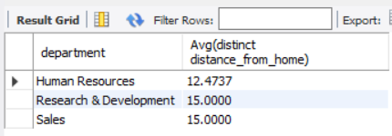

11) List employees who have changed their job roles within the company (JobLevel and JobRole differ from their previous job).
12) Find the average distance from home for employees in each department.

Slide 8
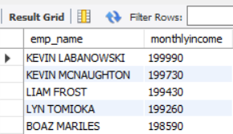

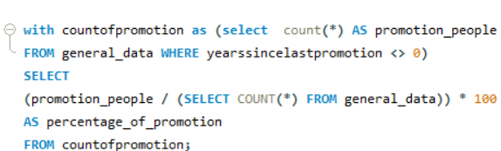

13) Retrieve the top 5 employees with the highest MonthlyIncome.
14) Calculate the percentage of employees who have had a promotion in the last year.

Slide 9
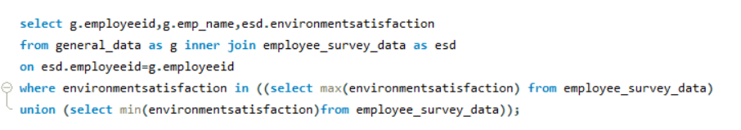
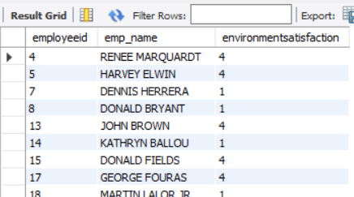
15) List the employees with the highest and lowest EnvironmentSatisfaction.

Slide 10
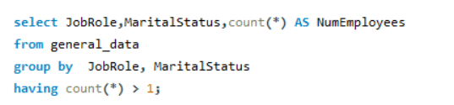
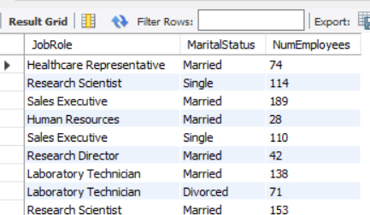
16) Find the employees who have the same JobRole and MaritalStatus.

Slide 11
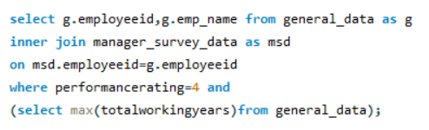
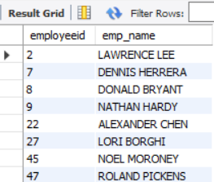
17) List the employees with the highest TotalWorkingYears who also have a PerformanceRating of 4.

Slide 12
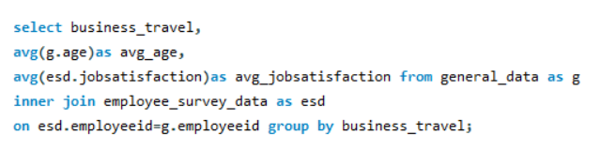
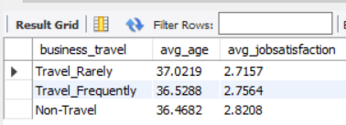
18) Calculate the average Age and JobSatisfaction for each BusinessTravel type.

Slide 13
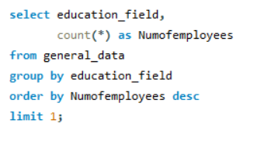

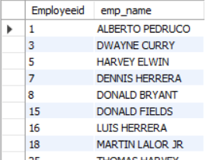

19) Retrieve the most common EducationField among employees.
20) List the employees who have worked for the company the longest but haven't had a promotion.

